Slide 1
Regression Analysis
Model Selection
Nicoleta Serban, Ph.D.
Professor
Stewart School of Industrial and Systems Engineering
Model Search

Slide 2

About This Lesson

Slide 3
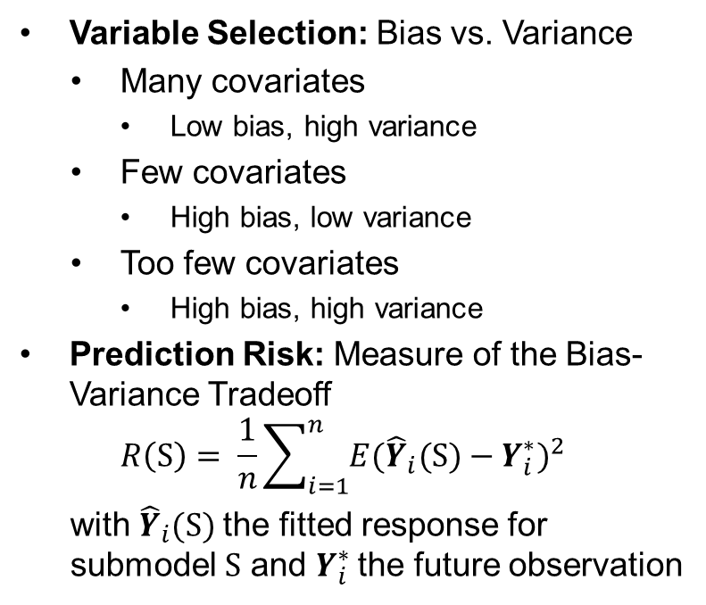
Bias-Variance Tradeoff
Variable Selection: Bias vs. Variance
  Many covariates
    Low bias, high variance
  Few covariates
    High bias, low variance
  Too few covariates
    High bias, high variance
Prediction Risk: Measure of the Bias-Variance Tradeoff
$$R\left(S\right)= \frac{1}{n}\sum_{i=1}^{n}{E{({\hat{Y}}_{i}(S)−Y_{i}^{∗})}^{2}}$$
with ${\hat{Y}}_{i}(S)$ the fitted response for submodel S and $Y_{i}^{∗}$ the future observation
Given an estimate of the prediction risk for a submodel S, choose the submodel with the smallest prediction risk.
How to search over all submodels?

Slide 4
Model Search
If p is the number of predicting variables, there are 2^{p} possible submodels
  If p is small
    Fit all submodels
  If p is large
    Search using heuristics/greedy search
Stepwise Regression
  Forward
    Start with no predictors, add one at a time
  Backward
    Start with all predictors, drop one at a time
  Forward-Backward
    Add and drop one variable at a time iteratively

Slide 5
Model Search
Stepwise regression is a greedy algorithm. It does not guarantee to find the model with the best score.
Forward stepwise regression is preferable to backward stepwise regression.
Forward stepwise regression does not necessarily select the same model as the one selected using backward stepwise regression.

Slide 6
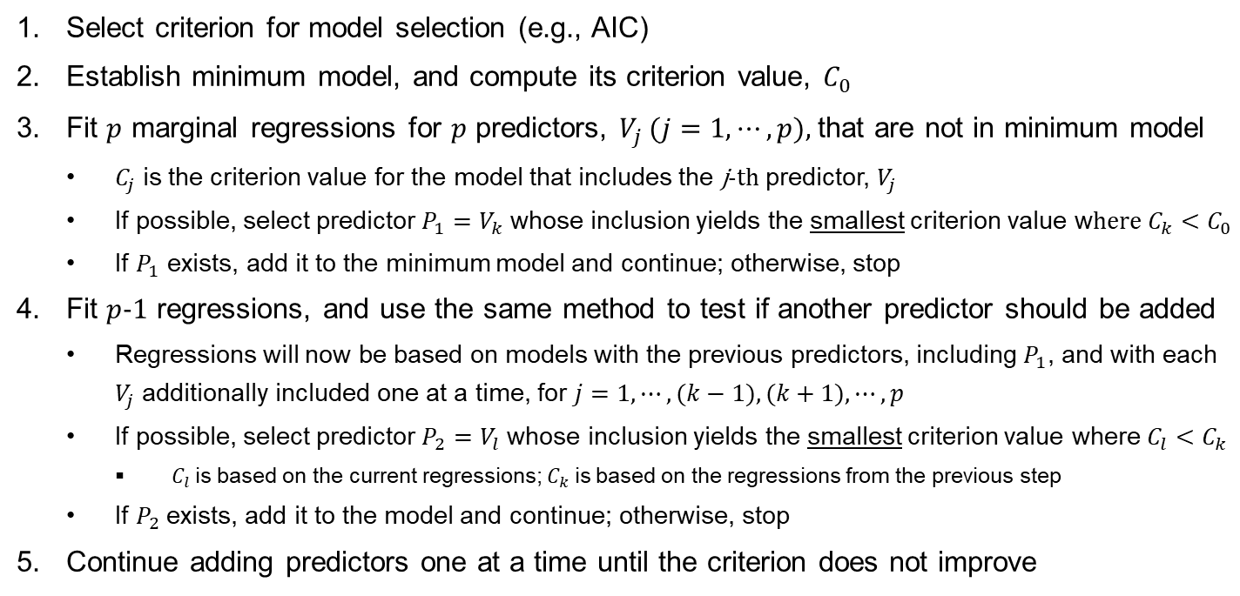
Forward Stepwise Regression
Select criterion for model selection (e.g., AIC)
Establish minimum model, and compute its criterion value, $C_{0}$
Fit $p$ marginal regressions for $p$ predictors, $V_{j}$ ($j=1,⋯,p$), that are not in minimum model
  $C_{j}$ is the criterion value for the model that includes the j-th predictor, $V_{j}$
  If possible, select predictor $P_{1}=V_{k}$ whose inclusion yields the smallest criterion value w$here C_{k}<C_{0}$
  If $P_{1}$ exists, add it to the minimum model and continue; otherwise, stop
Fit $p$-1 regressions, and use the same method to test if another predictor should be added
  Regressions will now be based on models with the previous predictors, including $P_{1}$, and with each $V_{j}$ additionally included one at a time, for $j=1,⋯,(k−1), (k+1),⋯,p$
  If possible, select predictor $P_{2}=V_{l}$ whose inclusion yields the smallest criterion value where$C_{l}<C_{k}$
    $C_{l}$ is based on the current regressions; $C_{k}$ is based on the regressions from the previous step
  If $P_{2}$ exists, add it to the model and continue; otherwise, stop
Continue adding predictors one at a time until the criterion does not improve

Slide 7
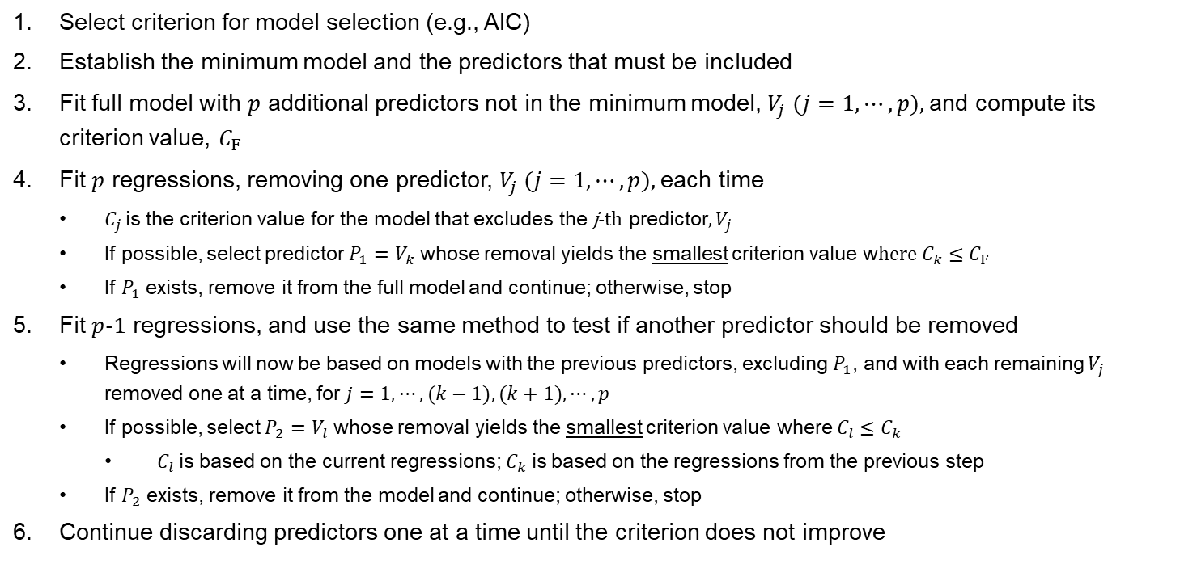
Backward Stepwise Regression
Select criterion for model selection (e.g., AIC)
Establish the minimum model and the predictors that must be included
Fit full model with $p$ additional predictors not in the minimum model, $V_{j}$ ($j=1,⋯,p$), and compute its criterion value, $C_{F}$
Fit $p$ regressions, removing one predictor, $V_{j}$ ($j=1,⋯,p$), each time
  $C_{j}$ is the criterion value for the model that excludes the j-th predictor, $V_{j}$
  If possible, select predictor $P_{1}=V_{k}$ whose removal yields the smallest criterion value w$here C_{k}≤C_{F}$
  If $P_{1}$ exists, remove it from the full model and continue; otherwise, stop
Fit $p$-1 regressions, and use the same method to test if another predictor should be removed
  Regressions will now be based on models with the previous predictors, excluding $P_{1}$, and with each remaining $V_{j}$ removed one at a time, for $j=1,⋯,(k−1), (k+1),⋯,p$
  If possible, select $P_{2}=V_{l}$ whose removal yields the smallest criterion value where $C_{l}≤C_{k}$
    $C_{l}$ is based on the current regressions; $C_{k}$ is based on the regressions from the previous step
  If $P_{2}$ exists, remove it from the model and continue; otherwise, stop
Continue discarding predictors one at a time until the criterion does not improve

Slide 8
Forward vs Backward Stepwise Regression
Backward stepwise regression:
Cannot be performed if there are more predictors than the sample size (p > n)
Is more computationally expensive than forward stepwise regression
Will select larger models if p is large

Slide 9

Summary

